Slide 1



Osteoporosis Canada
Recommendations for Preventing Fracture in
Long Term Care

Slide 2



Innovation & Education that Transforms Senior's Lives
c
T
E
Osteoporosis Ca nada
Osteoporose Canada

Slide 3
On behalf of Osteoporosis Canada’s Scientific
Advisory Committee, we acknowledge:
Alexandra Papaioannou, MD MSc FRCP(C) FACP
Nancy Santesso, PhD MLIS BASc RD
Suzanne Morin, MD MSc FRCP FACP
Sid Feldman, MD CCFP FCFP
Jonathan Adachi, MD FRCPC
Richard Crilly, MD MRCP(UK) FRCPC
Lora Giangregorio, PhD
Susan Jaglal, BSc MSc PhD
Robert Josse, MD BS BSc
Sharon Kaasalainen, BScN MSc PhD
Paul Katz, MD CMD
Andrea Moser, MD MSc CCFP FCFP
Hope Weiler, RD PhD
Susan Whiting, PhD
Angela Cheung, MD PhD FRCPC CCD
Papaioannou A et al. CMAJ. 2015

Slide 4
Objectives
Learn how to apply the 2015 Fracture Prevention Recommendations for frail older adults in long-term care
Improve fracture risk assessment and identification
of residents at high risk
Learn how to choose non-pharmacological and pharmacological therapies for residents at high risk of fracture
Papaioannou A et al. CMAJ. 2015

Slide 5
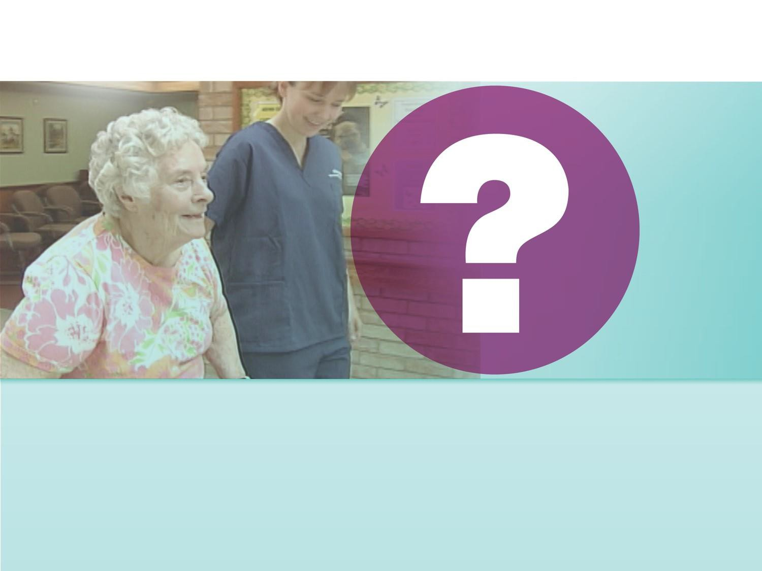
How common are fractures in older adults
in long-term care?

Slide 6
Prevalence of fracture in LTC
Prevalence of all fractures is higher in LTC
  Fracture rate for adults in LTC is 2-4 times that of similarly aged adults living in the community¹
  One third of older adults who experience hip fractures are
residents in LTC²
Up to 30% of residents have vertebral fracture³
¹Consensus Development Conference. Am J Med. 1991
²Crilly RG et al. J Aging Research. 2010
³Rodondi A et al. Osteoporos Int. 2012
Papaioannou A et al. CMAJ. 2015

Slide 7
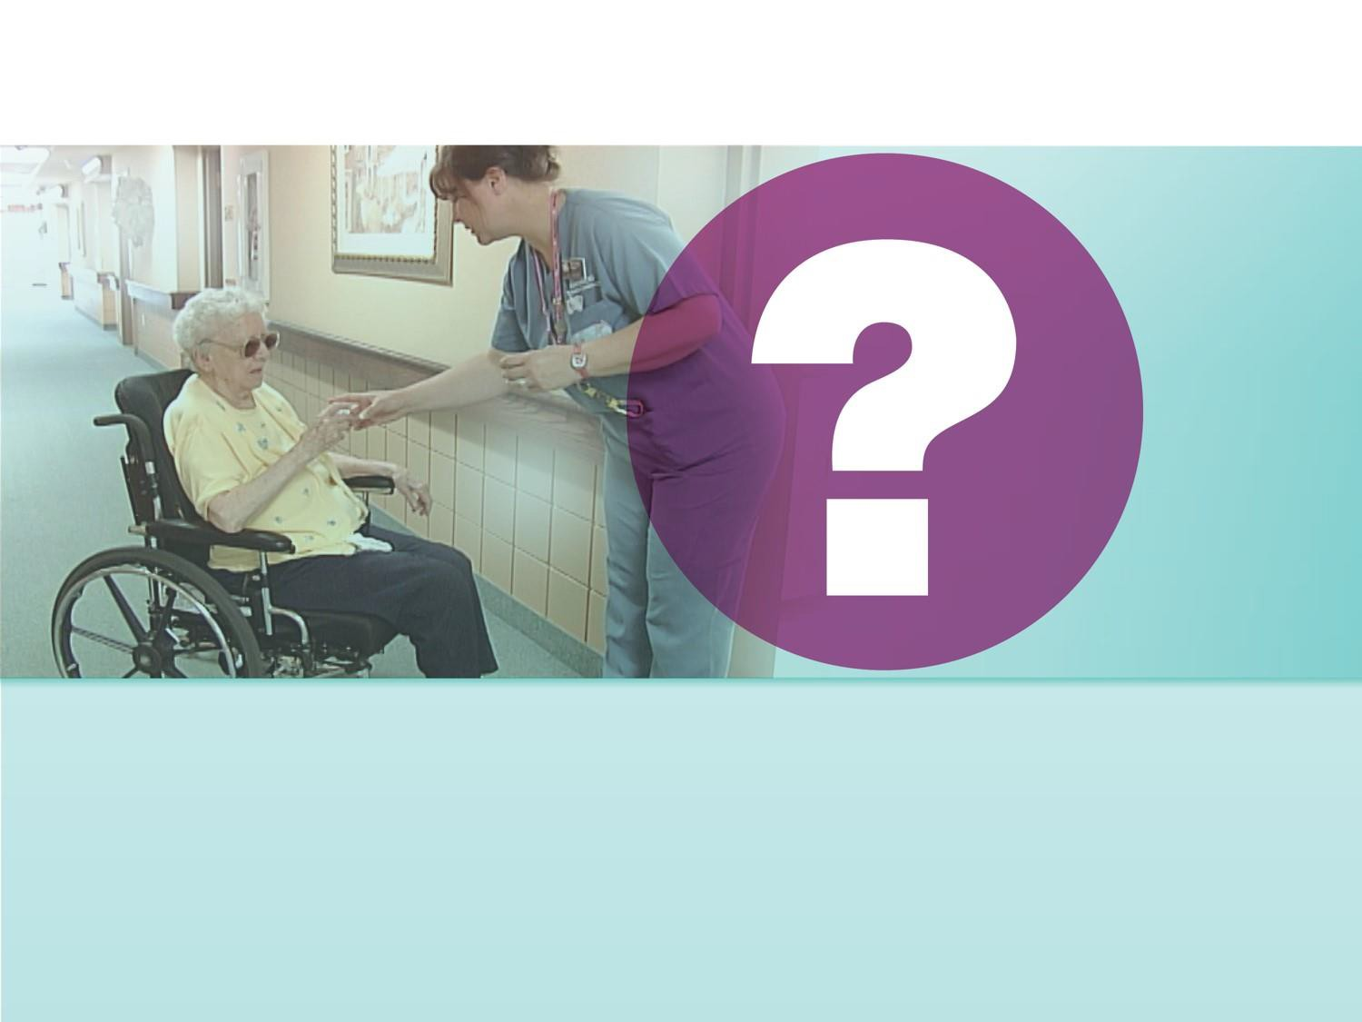
What is the impact of fractures?

Slide 8
Impact of fractures in LTC
Fragility fractures are responsible for excess mortality, morbidity, chronic pain, admission to institutions and economic costs¹⁻³
Those with hip or vertebral fractures have substantially
increased risk of death after the fracture²
Multiple vertebral fractures can cause significant pain, anxiety, depression, reduced pulmonary function and agitation⁴
¹Papaioannou A et al. Osteoporos Int. 2009 ²Ioannidis G et al. CMAJ. 2009 ³Wiktorowicz ME. Osteoporos Int. 2001 ⁴Papaioannou A et al. Am J Med. 2002
Papaioannou A et al. CMAJ. 2015

Slide 9



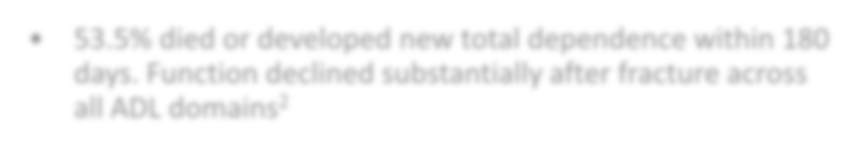



In women, a hip fracture leads to…
Future fracture
10% will re-fracture within one year¹
Decreased quality
of life
53.5% died or developed new total dependence within 180 days. Function declined substantially after fracture across all ADL domains²
Long-term care admissions
Up to 18% enter LTC³
1-year Mortality
¹Papaioannou A et al. J Soc Obstet Gynaecol Can. 2000
²Neuman M et al. JAMA Intern Medicine. 2014
³Jean et al. JBMR. 2012
20% for individuals returning to the community¹
40% for those living in LTC¹
Papaioannou A et al. CMAJ. 2015

Slide 10
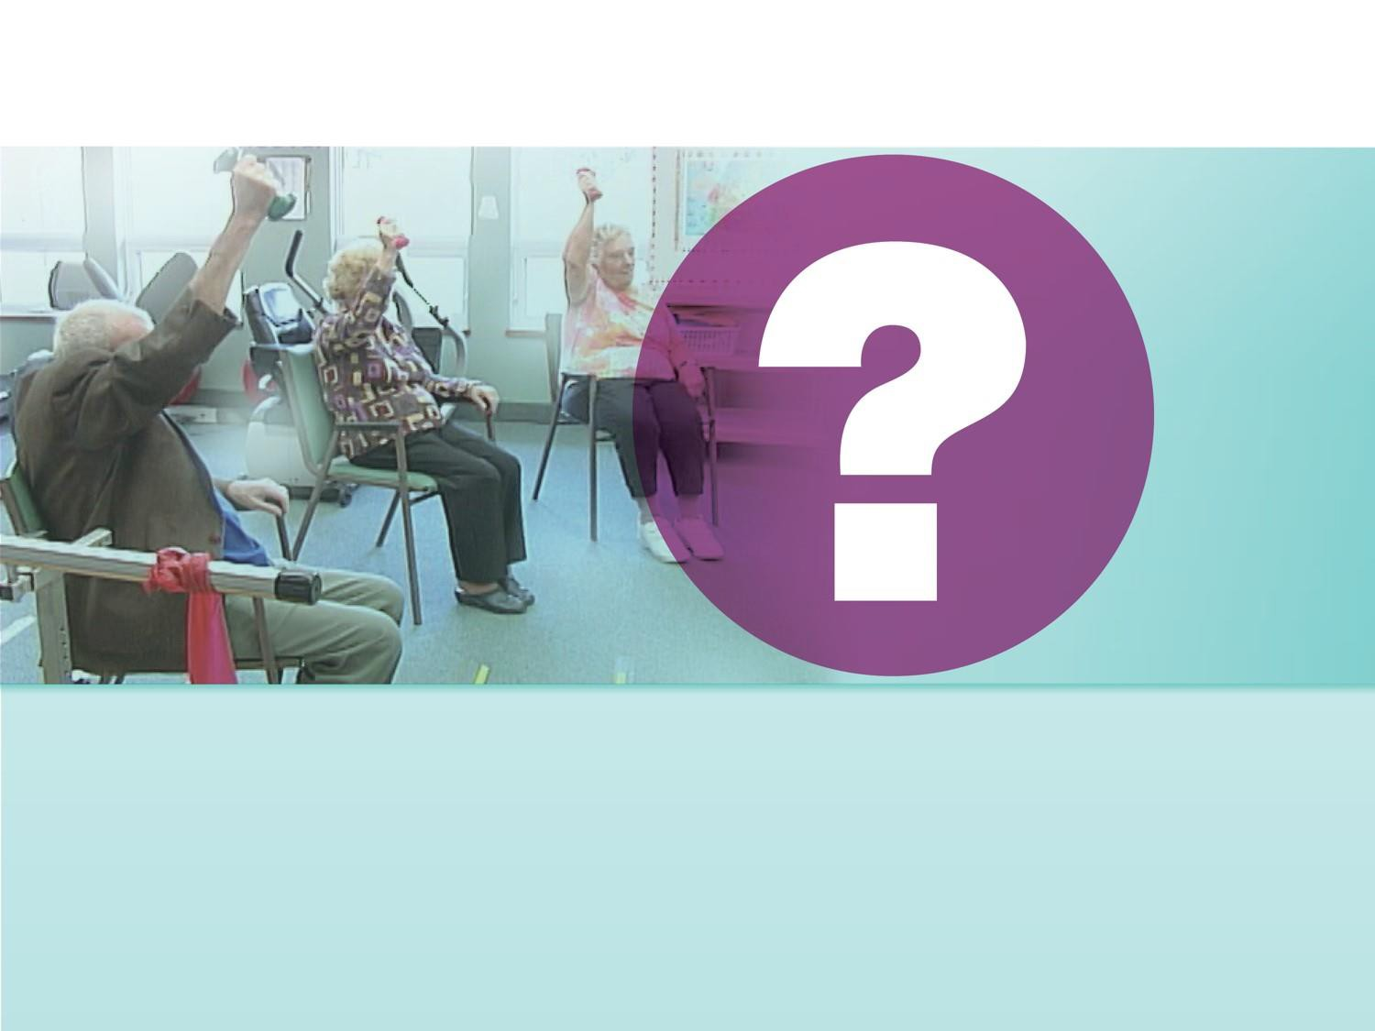
What is the goal of the Fracture Prevention
Recommendations?

Slide 11
Reduce immobility, pain, transfers to hospital and improve quality of living of residents
Papaioannou A et al. CMAJ. 2015

Slide 12
The Recommendations

Slide 13

The proposed recommendations integrate falls and osteoporosis assessment taking into consideration lifespan, renal impairment and simultaneous risks of falls and fractures
Recommendations consider various treatment strategies in addition to pharmacotherapy

Slide 14

How were the recommendations
developed?

Slide 15









Using the GRADE Approach¹
Balance of Benefits & Harms
Values & Preferences
Quality of
the Evidence
Resources
Recommendation
¹Balshem H et al. J Clin Epidemiol. 2011
Papaioannou A et al. CMAJ. 2015

Slide 16
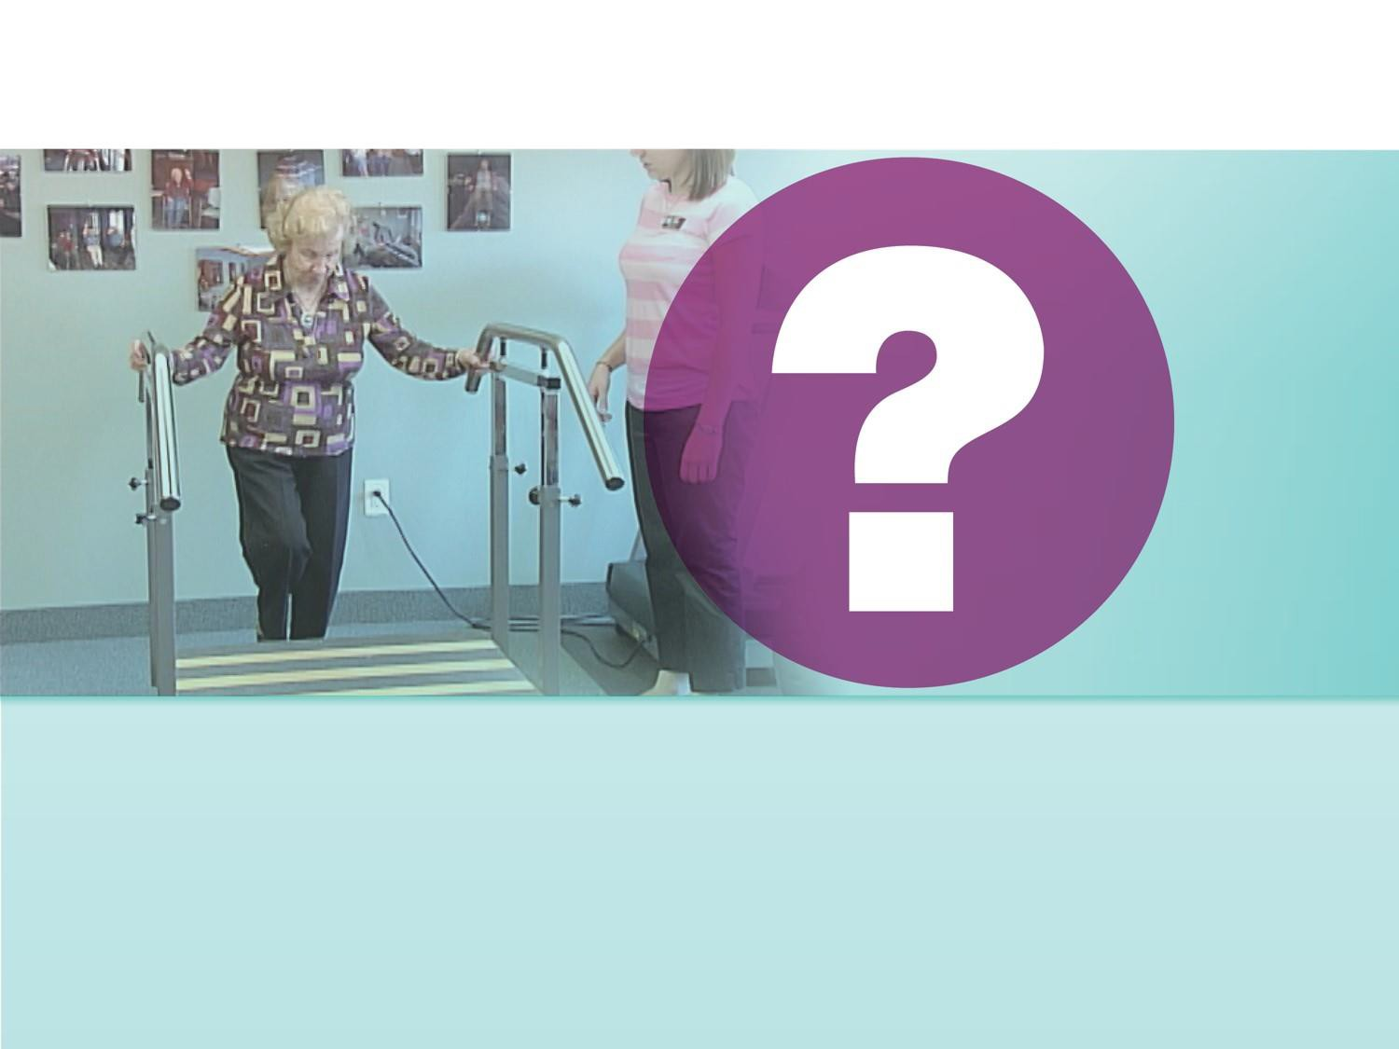
How can the recommendations be
interpreted?

Slide 17

Interpreting the recommendations¹
Implications | Strong Recommendation “we recommend”… | Conditional Recommendation “we suggest”…
FOR PATIENTS/RESIDENTS | Most individuals in this situation would want the recommended course of action, and only a small proportion would not | The majority of individuals in this situation would want the suggested course of action, but many would not
FOR CLINICIANS | Most individuals should receive the intervention | Clinicians recognize that different choices will be appropriate for each individual and that clinicians must help each individual arrive at a management decision consistent with his/her values and preferences
¹www.gradeworkinggroup.org
Papaioannou A et al. CMAJ. 2015

Slide 18

How do we assess high risk of fracture
in LTC?

Slide 19


Guidelines intervention groups
Recommendations for interventions to prevent fracture were developed for the following groups:
Older residents in LTC at
high risk of fracture
Older residents in LTC not
at high risk of fracture
Papaioannou A et al. CMAJ. 2015

Slide 20
Who is at HIGH risk for fractures?

Slide 21
Ask the following questions on admission¹
Determine… | How to assess?...
Prior hip fracture | “have you ever broken your hip?”
Prior vertebral fracture | “have you lost height?” If YES and >6 cm historically, order lateral thoracic and lumbar spine
More than one prior fracture (excluding fractures of the hands/feet/ankle) | “have you had a broken bone after 50?”
If recently used systemic glucocorticoids and have had one prior fracture | Are you using medications such steroids or prednisone?
If identified as high risk and/or on osteoporosis treatment prior to admission | “have you been on osteoporosis medications?
BMD is not required to identify residents at high risk of fracture
¹Papaioannou A et al. CMAJ. 2010
Papaioannou A et al. CMAJ. 2015

Slide 22
If the answer is YES to any of the previous questions, the resident is considered at HIGH RISK for fracture
Papaioannou A et al. CMAJ. 2015

Slide 23

What are the recommendations for calcium
and vitamin D?

Slide 24
Considerations in supplementation
Oro-pharyngeal Dysphagia
  7 to 40% of LTC residents¹
  Common in neurological diseases¹
  Variable ability to swallow liquids or mixed textures
  Supplement options
    Pills: If can crush and mix with food (ensure small volume)
      If can’t crush, consider liquid alternative or other route of administration
    Liquids: assess thickness, mix with foods (attention to small volumes)
    Specially fortified foods might help improve vitamin D intakes and should be considered where feasible in LTC
      One study achieved 488 ± 132 IU/d vitamin D²
¹Namasivayam & Steele, J Nutr Gerontol Geriatr 2015;
²Adolphe et al, Can J Diet Prac Res 2009
Papaioannou A et al. CMAJ. 2015

Slide 25
Calcium
For all residents, we recommend dietary interventions to meet the recommended dietary allowance (RDA) for calcium
– The RDA for people >70 years for calcium is 1200 mg daily (3 servings of dairy or dairy equivalents)
Papaioannou A et al. CMAJ. 2015

Slide 26
Calcium
For residents at high risk who cannot meet the RDA for calcium through dietary intake, we recommend daily supplements of calcium up to 500 mg
For residents who are not at high risk of fractures and who cannot meet the RDA for calcium through dietary intake, we suggest daily supplements of calcium up to 500 mg, depending on resources and their (or their caregiver’s) values and preferences
Papaioannou A et al. CMAJ. 2015

Slide 27
Vitamin D
For residents at high risk of fractures, we recommend daily supplements of 800 – 2000 UNITS vitamin D₃
For residents not at high risk, we suggest daily supplements of 800 – 2000 UNITS vitamin D₃, depending on resources and their (or their caregiver’s) values and preferences
Papaioannou A et al. CMAJ. 2015

Slide 28
What are the recommendations for
exercise?

Slide 29
Exercise
For residents at high risk of fractures, we suggest balance, strength and functional training exercises only when part of a multifactorial intervention to prevent falls
  This recommendation places a high value on avoiding the small increase in falls which may occur among individuals at high risk of falls who participate in exercises, such as balance, strength and functional training
For residents not at high risk, we suggest balance, strength and functional training exercises to prevent falls
  This recommendation places a high value on the probably small reduction in falls that is achieved with exercise, as falls may lead to serious injuries. It also places high value on the other benefits that exercise could provide.
Papaioannou A et al. CMAJ. 2015

Slide 30
What are multifactorial interventions and
recommendations?

Slide 31
Multifactorial interventions
Any combination of interventions that are tailored to an
individual’s risk to reduce falls.
Such interventions may include:
– medication reviews, assessment of environmental hazards, use of assistive devices, exercise, management of urinary incontinence and educational interventions directed to staff
For all residents, we suggest multifactorial interventions that are individually tailored to reduce the risk of falls and fractures
Papaioannou A et al. CMAJ. 2015

Slide 32
What are the recommendations for the use
of hip protectors?

Slide 33
Hip protectors
For residents who are mobile and at high risk of fractures, we
recommend hip protectors
For residents who are not at high risk of fracture but are mobile, we suggest hip protectors depending on resources available and the residents’ values and preferences.
Papaioannou A et al. CMAJ. 2015

Slide 34
What are pharmacological therapy
recommendations for older adults?

Slide 35
We calculated effects of benefits and harms at one year or more and therefore, these recommendations apply to older persons with life expectancy greater than one year
Papaioannou A et al. CMAJ. 2015

Slide 36








For HIGH RISK residents, we recommend..
Recommended Administration:
✓Not to be crushed
✓In the morning, on an empty stomach
✓If resident can remain upright for 30 min after administration
Alendronate
70 mg weekly
1st line therapy
Risedronate
35 mg weekly or
150 mg monthly
NOTE
Risedronate DR can be taken immediately after breakfast and is not required to be taken first thing in the morning on an empty stomach.
Papaioannou A et al. CMAJ. 2015

Slide 37

Contraindications
Alendronate and risedronate are not recommended for older persons with severe renal insufficiency (creatinine clearance <35 mL/min or <30 mL/min, respectively)
Papaioannou A et al. CMAJ. 2015

Slide 38





For HIGH RISK Residents + Difficulty Taking Oral Medications, we recommend..
*This recommendation applies to the older persons who have difficulty taking oral medications due to dysphagia, an inability
to sit up for 30 min, cognitive impairment or intolerance
Denosumab* (60 mg
subcut twice yearly)
1st line therapy
Zoledronic Acid (5mg IV yearly)
Papaioannou A et al. CMAJ. 2015

Slide 39
Contraindications
Denosumab:
While denosumab can be prescribed to residents with renal
impairment, they are at higher risk of developing hypocalcemia
Zoledronic Acid:
Health Canada advises that caution is necessary for people who receive other medications that could affect renal function; CrCl should be monitored before and periodically after treatment. Appropriate hydration (500 mL of water) is necessary before and after treatment. This medication should not be administered in people with severe renal impairment (CrCl <30 mL/min)
Papaioannou A et al. CMAJ. 2015

Slide 40


For HIGH RISK residents, we suggest...
Although the benefits of teriparatide (in particular on vertebral fracture) probably outweigh harms of treatment, the cost of therapy restricts its access, and there may be a higher burden due to daily injections
Teriparatide
(20 mcg subcut daily)
Papaioannou A et al. CMAJ. 2015

Slide 41



For HIGH RISK Residents, we suggest not to use…
There is moderate quality evidence for little to no reduction in fractures (in particular hip fractures) with etidronate. The cost is also high given the lack of important benefits.
Etidronate
Raloxifene
The harms of raloxifene (e.g. venous thromboembolism and musculoskeletal events – arthralgia, myalgia) probably outweigh the probable reduction in vertebral fractures and small reductions in hip and non-vertebral fractures
Papaioannou A et al. CMAJ. 2015

Slide 42
Summary
Determine risk of fracture on resident’s admission
  Calcium and vitamin D
supplementation
    Exercise, hip protectors and
multifactorial interventions
      Pharmacological therapy
for residents at high risk
Papaioannou A et al. CMAJ. 2015

Slide 43
For access to recommendations and other tools and resources, please visit:
Osteoporosis Canada at: www.osteoporosis.ca
OR
Ontario Osteoporosis Strategy at:
www.osteostrategy.on.ca
Papaioannou A et al. CMAJ. 2015

